Slide 1

SHOP MANAGEMENT SYSTEM
During
III Year I Semester
Submitted to
The Department of Information Technology
In partial fulfilment of the academic requirements of Jawaharlal Nehru Technological University
For
The award of the degree of
Bachelor of Technology in
Information Technology
By
LAKAVATH KEERTHI
22315A1227
Sreenidhi Institute of Science and Technology Yamnampet, Ghatkesar, R.R. District, Hyderabad – 501301 Affiliated to
Jawaharlal Nehru Technology University Hyderabad - 500085
Department of Information Technology

Slide 2
CERTIFICATE
This is to certify that this Summer Industry Internship –I report on “SHOP MANAGEMENT SYSTEM”,submitted by YENKAMOLLA SRINIDHI(22315A1223),LAKAVATH
KEERTHI(22315A1227) in the year 2023 in partial fulfilment of the academic
requirements of Jawaharlal Nehru Technological University for the award of the degree of Bachelor of Technology in Information Technology, is a bonafide work- summer industry internship that has been carried out during II B Tech IT II semester, will be evaluated in III B Tech IT I Semester , under our guidance. This report has not been submitted to any other institute or university for the award of any degree.
Mr.A.Ravi Kumar | Mrs.N.Sreevidya | Dr.Sunil Bhutada
Assistant Professor | Assistant Professor | Professor
Department of IT Internal Guide | Department of IT Internship Coordinator | Department of IT Head of Department
External Examiner Date:-

Slide 3
DECLARATION
We, YENKAMOLLA SRINIDHI (22315A1223),LAKAVATH KEERTHI (22315A1227),students of SREENIDHI INSTITUTE OFSCIENCE AND TECHNOLOGY, YAMNAMPET, GHATKESAR, studying III rd year I stsemester, INFORMATION TECHNOLOGY solemnly declare that the Summer IndustryInternship-I report , titled “SHOP MANAGEMENT SYSTEM” is submitted to SREENIDHI INSTITUTE OF SCIENCE AND TECHNOLOGY for partial fulfilment for the award of degree of Bachelor of technology in INFORMATION TECHNOLOGY.
It is declared to the best of our knowledge that the work reported does not form part of any dissertation submitted to any other University or Institute for award of any degree.

Slide 4
ACKNOWLEDGEMENT
I would like to express my gratitude to all the people behind the screen who helped me to transform an idea into a real application.
I would like to thank my Project coordinator Mr.A.RAVI KUMAR for her technical guidance, constant encouragement and support in carrying out our project at college.
I profoundly thank Dr.SUNIL BHUTADA, Head of the Department of Information Technology who has been an excellent guide and also a great source of inspiration to my work
I would like to express my heart-felt gratitude to my parents without whom I would not have been privileged to achieve and fulfil my dreams. I am grateful to our principal, Dr. T. Ch. Siva Reddy, who most ably run the institution and has had the major hand in enabling me to do my project.
The satisfaction and euphoria that accompany the successful completion of the task would be great but incomplete without the mention of the people who made it possible with their constant guidance and encouragement crowns all the efforts with success. In this context, I would like thank all the other staff members, both teaching and non-teaching, who have extended their timely help and eased my task.
YENKAMOLLA SRINIDHI LAKAVTATH KEERTHI
22315A1223
22315A1227

Slide 5
SHOP MANAGEMENT SYSTEM
Abstract
Shop management system helps to store the database of the shop including item name, item price, item quantity,
item category, item discount. So we can easily find out if we need any data about the shop. Its a very interesting project in python programming. Lets develop shop management system using python modules.Shop Management System is a GUI-based project using Tkinter and a message module used for storing the database of shops.We can add new items that are bought by the customers, we can delete any particular item and we can search for any item. We can view all the
databases that we have stored in the file.
Shop management system requires good knowledge of python and the Tkinter library. Tkinter is the python binding to the Tk toolkit which is used across many programming languages for building the Graphical user interface which is a GUI, known about os library. Also known about the tkinter message box which is used to display the message box on the python game window. To work on this project basic understanding of the os module is also required.
The Shop Management System is a sophisticated and all-encompassing solution that seeks to redefine the landscape of retail operations. At its core, this system is a powerhouse of efficiency, offering an array of features meticulously crafted to enhance every facet of business management.
The management component stands out as a pivotal feature, leveraging advanced algorithms to ensure optimal stock levels. By minimizing the risks of overstock and stockouts, it not only prevents financial losses but also contributes to a seamless customer experience. Real-time sales tracking adds another layer of functionality, providing invaluable insights into product performance, trends, and customer preferences. This data-driven approach empowers businesses to make informed decisions, adapt quickly to market shifts, and stay ahead of the competition.

Slide 6
TABLE OF CONTENTS
1.INTRODUCTION……………………………………………………..10-11
1.1.SCOPE………………………………………………………………………….10
1.2.EXISTING SYSTEM…………………………………………………………11
1.3.PROPOSED SYSTEM………………………………………………………11
2.SYSTEM DESIGN……………………………………………………..11-15
2.1.ARCHITECTURE…………………………………………………………….12
2.2.FLOW CHART………………………………………………………………..12
2.3.UML DIAGRAMS……………………………………………………………13
2.3.1.CLASS DIAGRAM…………………………………………………………………….13
2.3.2.COMPONENT DIAGRAM…………………………………………………………13
2.3.3.SEQUENCE DIAGRAM……………………………………………………………..14
2.3.4.USECASE DIAGRAM………………………………………………………………..14
2.3.5.ER DIAGRAM….……………………………………………………………………….15
3.SYSTEM IMPLEMENTION………………………………………….15-21
3.1.SOURCE CODE……………………………………………………………….17
4.OUTPUT SCREENS………………………………………………………19
5.INTERNSHIP FEEDBACK………………………………………………21
6.CONCLUSION……………………………………………………………..22
7.FUTURE SCOPE…………………………………………………………..23
8.BIBILIOGRAPHY…………………………………………………………..23
APPENDIX-A…………………………………………………………………..24 APPENDIX-B…………………………………………………………………..26

Slide 7
1.INTRODUCTION
A Shop Management System implemented in Python is a robust solution designed to streamline and automate various tasks associated with running a retail or wholesale business. This system is a testament to the power of programming in enhancing business operations, improving efficiency, and providing a user-friendly interface for managing diverse aspects of the retail domain.At its core, the Shop Management System utilizes the Tkinter library for creating a graphical user interface (GUI) that allows users to interact seamlessly with the application. Tkinter, being a standard GUI toolkit for Python, provides the necessary tools for building an intuitive and visually appealing interface, facilitating a smooth user experience.The system revolves around a centralized database file, named “Proj_Database,” which serves as the repository for storing crucial information about the shop’s inventory. Each line in this file corresponds to a specific item, capturing details such as its name, price, quantity, category, and applicable discount.The main features of the system include the ability to add, dele() te, and search for items, view the entire database, clear the screen, and exit the application. These functions employ file handling operations to manipulate the database file based on user input, ensuring the integrity of the stored information.The user interface consists of abelled entry fields and buttons, providing a structured layout for inputting and processing data. Labels prompt users to enter item details such as name, price, quantity, category, and discount, while entry widgets facilitate user input. The system incorporates buttons for performing specific actions, such as adding or deleting items, viewing the database, searching for items, clearing the screen, and exiting the application.One notable aspect is the inclusion of error handling mechanisms, ensuring that the system gracefully handles unexpected scenarios.Moreover, the system embraces modular programming practices by defining distinct functions for each specific operation, contributing to code readability and maintainability. This modular approach also allows for future enhancements or modifications to be implemented with ease.The Shop Management System implemented in Python exemplifies the power of programming in creating practical solutions for business management. Through its user- friendly interface, efficient data handling, and comprehensive features, this system empowers businesses to navigate the complexities of inventory management, sales tracking, and customer interactions with greater ease and efficiency. As technology continues to evolve, such applications play a crucial role in modernizing and optimizing business operations.
1.1.SCOPE
The scope of a Shop Management System is vast, encompassing a wide range of functionalities and potential improvements to enhance business operations. The scope extends to customization options, scalability for business growth, compliance with regulations, and technical support and updates for system maintenance. The scope is designed to address the diverse needs of modern retail businesses and contribute to a seamless and customer-centric shopping experience.
Here is an overview of the scope of a Shop Management System: 1.Inventory Management

Slide 8
2.Sales Billing
3..Cutomer Management
4.Supplier Management
5.User Authentication and Authorization
6.Multi-User Support
7.Feedback Mechanism
1.2.EXISTING SYSTEM
The Shop Management System implemented in Python is a comprehensive solution for handling various aspects of retail and wholesale business operations. The graphical user interface (GUI) is created using the Tkinter library, providing a user-friendly platform for efficient management. They designed to streamline various aspects of retail operation.
Point of Sale
Customer Relationship Management(CRM)
3.E-commerce integration
4.Customization and Scalability
5.Reporting and Analytics
6.User Friendly Interface
1.3.PROPOSED SYSTEM
A proposed shop management system would be a comprehensive solution designed to streamline and optimize various aspects of retail operations. The system would incorporate a range of features to enhance efficiency, accuracy, and customer satisfaction. Here are key components of the proposed shop management system:
1.Order Processing
2.Promotions and Discounts
3.Multi Currency Support
4.Customer Feedbacks and Reviews
5.Social Media Integration
Warranty and Returns Management

Slide 9

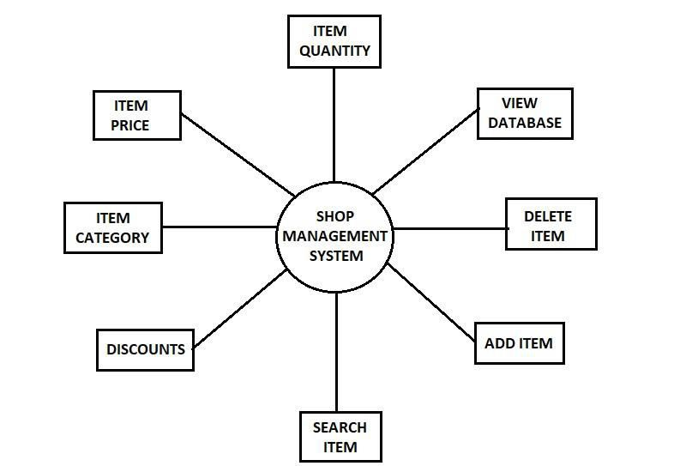
2.SYSTEM DESIGN
2.1 ARCITECTURE
2.2 FLOW CHART

Slide 10
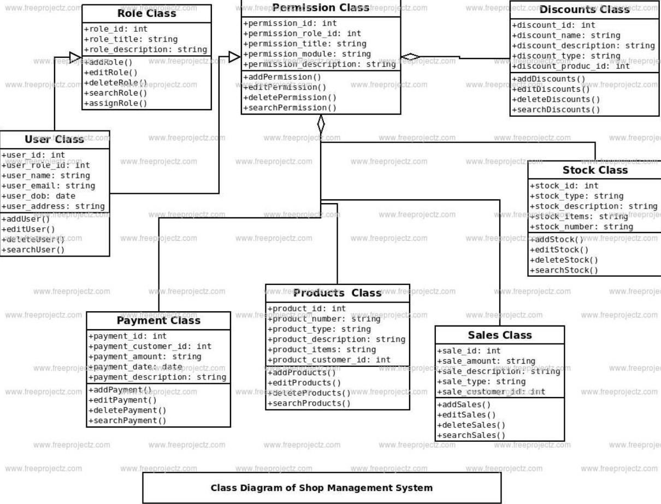
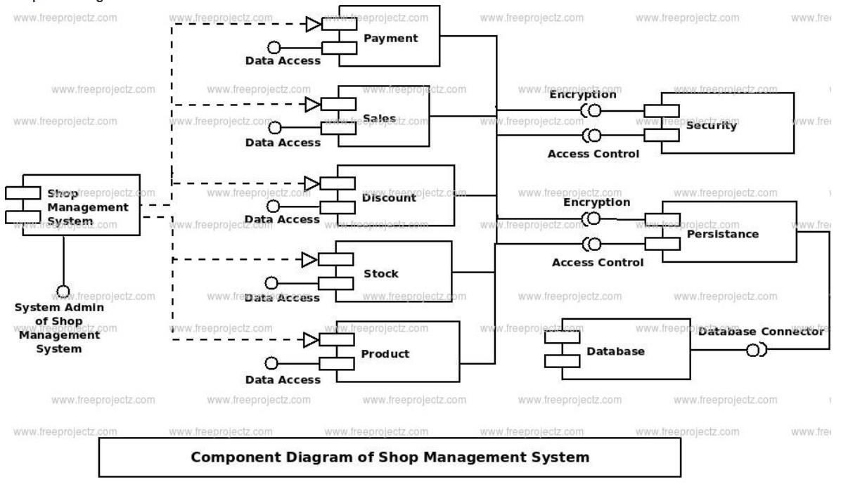
  2.3UML DIAGRAMS
    2.3.1.Class Diagram:
2.3.2.Component Diagram:

Slide 11
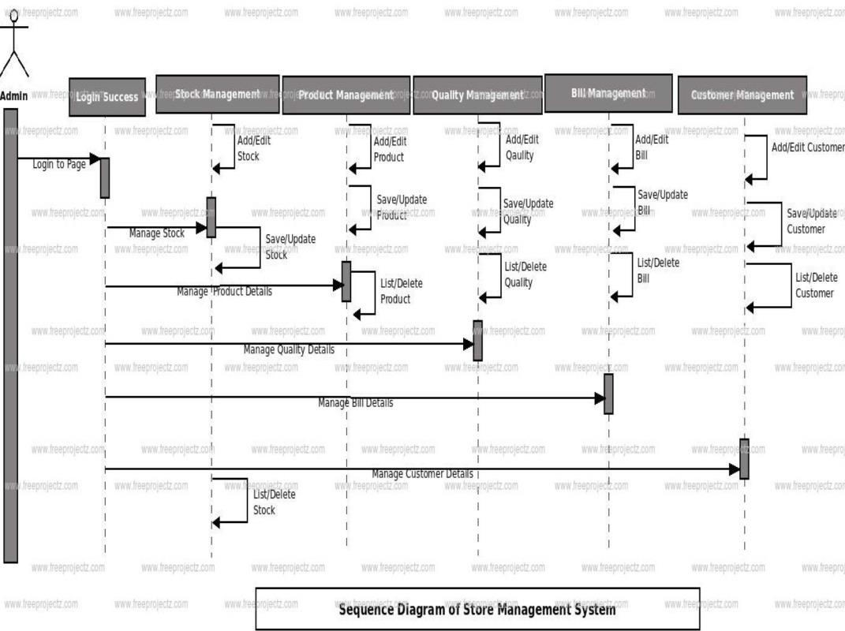
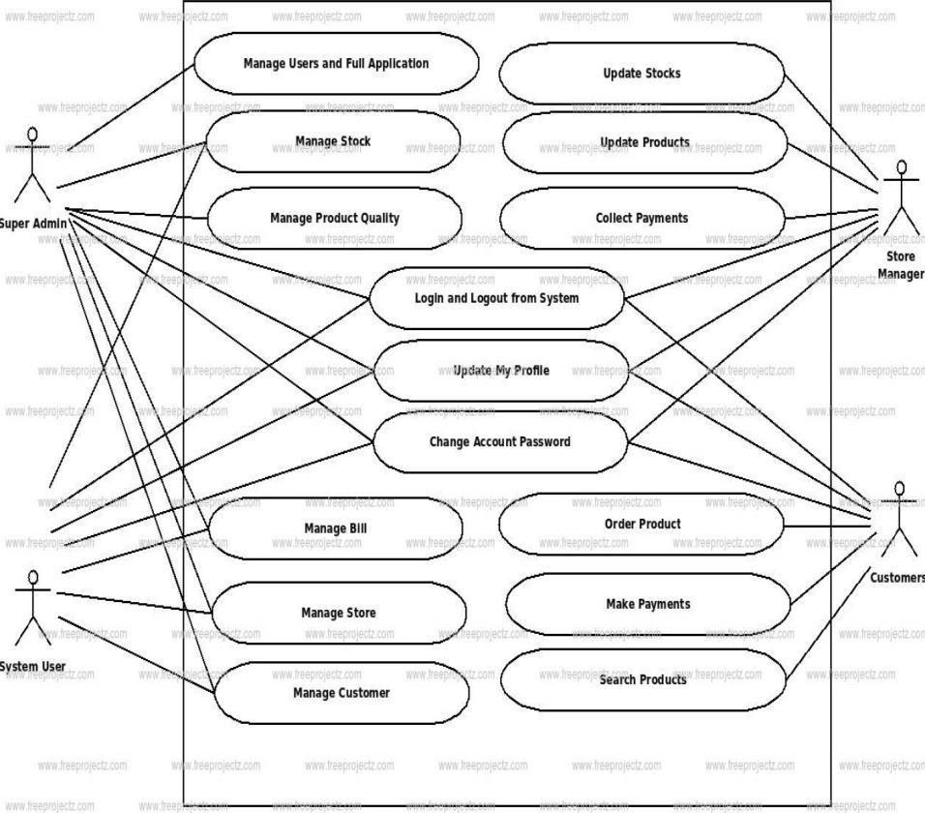
2.3.3.Sequence Diagram:
2.3.4.Use Case Diagram

Slide 12
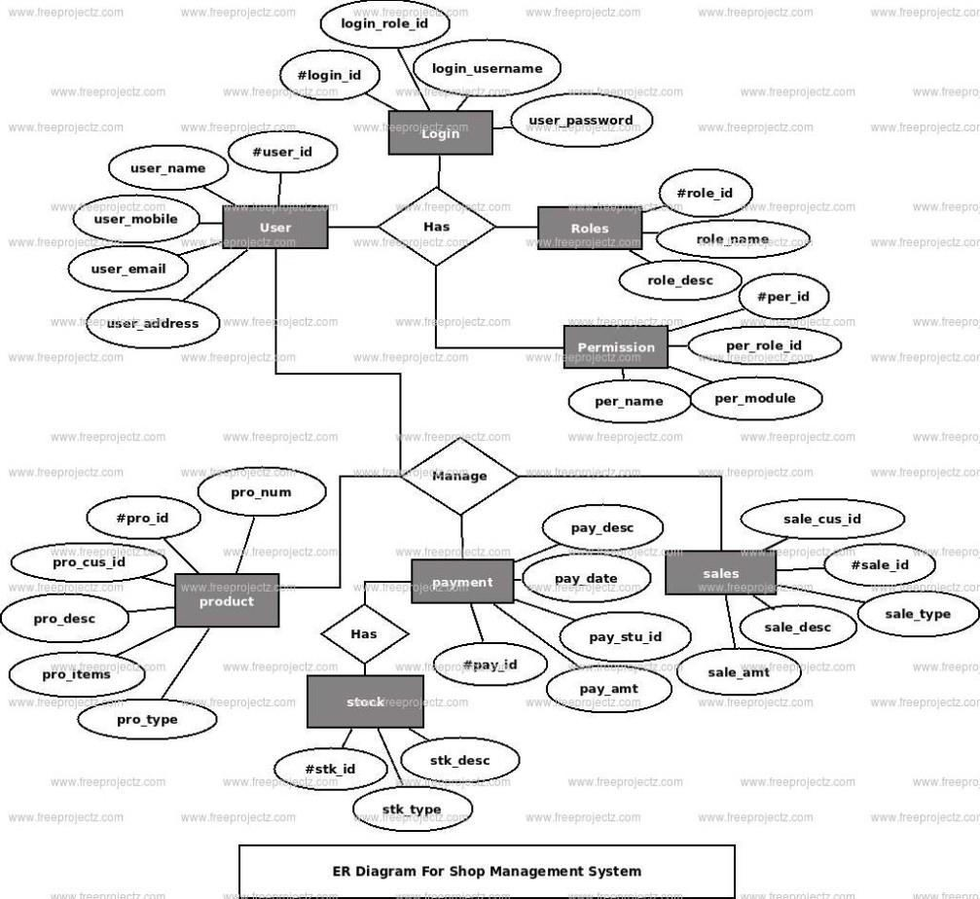
2.3.5.ER DIAGRAM:

Slide 13
3.SYSTEM IMPLEMENTATION
Implementing a shop management system using Python involves several steps. Below is a simplified outline to give you an idea of the process. Note that this is a high-level overview, and the actual implementation may vary based on specific requirements and the complexity of the system.
1. | Requirements Analysis:
 |  | Define the specific requirements of the shop management system. Identify key functionalities such as inventory management, POS, employee management, and reporting.
2. | Design:
 |  | Create a system design that includes data models, user interfaces, and the overall architecture. Choose appropriate data structures and algorithms for efficient data handling.
3. | Database Design:
 |  | Choose a database system (e.g., SQLite, MySQL, PostgreSQL) for storing data. Design the database schema to accommodate information related to products, customers, sales, etc.
4. | User Interface Design:
 |  | Design the user interfaces for different system modules using a GUI framework (e.g., Tkinter, PyQt, Kivy). Consider a user-friendly layout for POS terminals and admin interfaces.
5. | Backend Development:
 |  | Implement the backend logic using Python. Develop functions and classes for tasks such as inventory management, sales processing, and user authentication.
6. | Database Integration:
 |  | Connect the Python application to the chosen database. Implement functions to perform database operations such as CRUD (Create, Read, Update, Delete).
7. | Frontend Development:
 |  | Implement the frontend using the previously designed user interfaces. Integrate the frontend with the backend using appropriate communication protocols.
8. | POS Terminal Implementation:
 |  | Develop the POS terminal functionality with features for processing sales transactions, accepting payments, and generating receipts.
9. | Integration of Additional Features:
 |  | Implement additional features based on your system requirements, such as customer relationship management, employee scheduling, or analytics.

Slide 14
 |  | Perform integration testing to ensure different modules work together seamlessly. Test the system with sample data to identify and fix any bugs or issues.
10. | Deployment:
 |  | Package the application for deployment. Choose a deployment environment (e.g., local servers, cloud services) based on the business's needs.
11. | Training and Documentation:
 |  | Train staff on how to use the shop management system. Create documentation, including user manuals and troubleshooting guides.
12. | Maintenance and Updates:
 |  | Monitor the system's performance in a real-world environment. Address any issues that arise and provide regular updates to improve functionality or add new features.
Remember, the actual implementation may vary based on the scale and specific requirements of your shop management system. Additionally, security measures should be considered, especially when handling sensitive data such as customer information and financial transactions.
3.1.SOURCE CODE:
#import modules
from tkinter import *
import tkinter as tk
from tkinter import messagebox
import os
f=open("Proj_Database",'a+’)
root = Tk()
root.title("Shop Managment System") root.configure(width=1500,height=600,bg="#e3f4f1") var=-1
#function to add items def Add_Items():
global var num_lines = 0
with open("Proj_Database", 'r') as f10:
for line in f10:
num_lines += 1

Slide 15
var=num_lines-1
E1= Entry_1.get()
E2=Entry_2.get()
E3=Entry_3.get()
E4=Entry_4.get()
E5=Entry_5.get()
f.write('{0} {1} {2} {3} {4}\n'.format(str(E1),E2,E3,str(E4),E5))
Entry_1.delete(0, END)
Entry_2.delete(0,END)
Entry_3.delete(0, END)
Entry_4.delete(0, END)
Entry_5.delete(0, END)
messagebox.showinfo("ADD ITEM", "ITEM ADDED SUCCESSFULLY....!!!!!")
#function to delete items def Delete_Items():
E1=Entry_1.get()
with open(r"Proj_Database") as f, open(r"Proj_Database1", "w") as working:
for line in f:
if str(E1) not in line:
working.write(line)
Entry_1.delete(0, END)
Entry_2.delete(0, END)
Entry_3.delete(0, END)
Entry_4.delete(0, END)
Entry_5.delete(0, END)
os.remove(r"Proj_Database")
os.rename(r"Proj_Database1", r"Proj_Database")
messagebox.showinfo("DELETE ITEM", "ITEM DELETED SUCCESSFULLY....!!!!!")
f.close()
working.close()
def list():
global var
var=0
f.seek(var)
root_1 = Tk()
root_1.configure(bg="Gray")
root_1.title("Stationary Store Database")
scroll = Scrollbar(root_1)
scroll.pack( side = RIGHT, fill = Y)
My_text = Text(root_1, yscrollcommand = scroll.set ,width=24,height= 18 ,bg= "gray",fg="black", font=("Times", 16))
string = f.read()
My_text.insert(END,string)
My_text.pack( side = LEFT, fill = BOTH )
scroll.config( command = My_text.yview )

Slide 16
def Search_Item():
Entry_1.delete(0, END)
Entry_2.delete(0, END)
Entry_3.delete(0, END)
Entry_4.delete(0, END)
Entry_5.delete(0, END)
i=0
flag = 1
E1 = Entry_6.get()
with open(r"Proj_Database") as working:
for line in working:
i=i+1
if str(E1) in line:
flag = 0
break
try:
if flag != 1:
v = list(line.split(" "))
Entry_1.delete(0, END)
Entry_2.delete(0, END)
Entry_3.delete(0, END)
Entry_4.delete(0, END)
Entry_5.delete(0, END)
Entry_1.insert(0, str(v[0]))
Entry_2.insert(0, str(v[1]))
Entry_3.insert(0, str(v[2]))
Entry_4.insert(0, str(v[3]))
Entry_5.insert(0, str(v[4]))
except:
messagebox.showinfo("Title", "error end of file")
if flag !=0:
messagebox.showinfo("Title", "NOT FOUND")
working.close()
def Clear_Item():
Entry_1.delete(0, END)
Entry_2.delete(0, END)
Entry_3.delete(0, END)
Entry_4.delete(0, END)
Entry_5.delete(0, END)
Entry_6.delete(0, END)
def Exit():
Exit= messagebox.askyesno("Exit the System","Do you want to Exit(y/n)?")
if Exit > 0:
root.destroy()
return

Slide 17
#All labels Entrys Button grid place
Label_0= Label(root,text="SHOP MANAGEMENT SYSTEM ",fg="black",font=("Times new roman", 30, 'bold'))
Label_0.grid(columnspan=6)
Label_1=Label(root,text="ENTER ITEM NAME",bg="#e8c1c7",fg="black",bd=8,font=("Times new roman", 12, 'bold'),width=25)
Label_1.grid(row=1,column=0)
Entry_1=Entry(root, font=("Times new roman", 14),bd=8,width=25)
Entry_1.grid(row=1,column=1)
Label_2=Label(root, text="ENTER ITEM PRICE",height="1",bg="#e8c1c7",bd=8,fg="black", font=("Times new roman", 12, 'bold'),width=25)
Label_2.grid(row=2,column=0)
Entry_2= Entry(root, font=("Times new roman", 14),bd=8,width=25)
Entry_2.grid(row=2,column=1)
Label_3=Label(root, text="ENTER ITEM QUANTITY",bg="#e8c1c7",bd=8,fg="black", font=("Times new roman", 12, 'bold'),width=25)
Label_3.grid(row=3,column=0)
Entry_3= Entry(root, font=("Times new roman", 14),bd=8,width=25)
Entry_3.grid(row=3,column=1)
Label_4=Label(root, text="ENTER ITEM CATEGORY",bg="#e8c1c7",bd=8,fg="black", font=("Times new roman", 12, 'bold'),width=25)
Label_4.grid(row=4,column=0)
Entry_4= Entry(root, font=("Times new roman", 14),bd=8,width=25)
Entry_4.grid(row=4,column=1)
Label_5=Label(root, text="ENTER ITEM DISCOUNT",bg="#e8c1c7",fg="black",bd=8, font=("Times new roman", 12, 'bold'),width=25)
Label_5.grid(row=5,column=0, padx=10, pady=10)
Entry_5= Entry(root, font=("Times new roman", 14),bd=8,width=25)
Entry_5.grid(row=5,column=1, padx=10, pady=10)
Button_1= Button(root,text="ADD ITEM",bd=8, bg="#49D810", fg="black", width=25, font=("Times new roman", 12),command=Add_Items)
Button_1.grid(row=6,column=0, padx=10, pady=10)
Button_2= Button(root, text="DELETE ITEM",bd=8, bg="#49D810", fg="black", width =25, font=("Times new roman", 12),command=Delete_Items)
Button_2.grid(row=6,column=1, padx=40, pady=10)
Button_3= Button(root, text="VIEW DATABASE",bd=8, bg="#49D810", fg="black", width =25, font=("Times new roman", 12),command=list)
Button_3.grid(row=3,column=3, padx=40, pady=10)
Button_4= Button(root, text="SEARCH ITEM",bd=8, bg="#49D810", fg="black", width =25, font=("Times new roman", 12),command=Search_Item)
Button_4.grid(row=2,column=3, padx=40, pady=10)

Slide 18
Button_5.grid(row=4,column=3, padx=40, pady=10)
Button_6= Button(root,highlightcolor="blue",activebackground="red", text="Exit",bd=8, bg="#FF0000", fg="#EEEEF1", width=25, font=("Times", 40),command=Exit)
Button_6.place(x=635,y=337,height= 102,width=245)
Entry_6= Entry(root, font=("Times new roman", 14),justify='left',bd=8,width=25)
Entry_6.grid(row=1,column=3, padx=10, pady=10)
root.mainloop()
CODE EXPLANATION:
This Python code implements a simple Shop Management System using the Tkinter library for the graphical user interface (GUI). The system allows users to manage items in a store by adding, deleting, viewing, searching, and clearing the data.
Here is an overview of the code:
Importing Modules:
  The necessary modules, including tkinter, messagebox, and os, are imported to create the GUI and handle file operations.
Opening Database File:
  The code opens a file named "Proj_Database" in append mode ('a+'). This file is used as a simple database to store information about items.
Creating the GUI:
  The Tkinter Tk() function is used to create the main window of the application.
  Labels, entry fields, buttons, and other GUI elements are defined and placed within the window using the grid method.
Functions:
  Several functions are defined to perform various actions when buttons are clicked. These functions include adding items (Add_Items), deleting items (Delete_Items), viewing the database (list), searching for items (Search_Item), clearing the screen (Clear_Item), and exiting the application (Exit).
Database Operations:
  The code reads and writes to the "Proj_Database" file to perform operations such as adding and deleting items.
Displaying Database:
  The list function opens a new window to display the entire content of the database using a text widget.
Entry Widgets:
  Entry widgets are used to take input from the user for item details like name, price, quantity, category, and discount.
Buttons:
  Buttons are used to trigger various actions such as adding, deleting, viewing, searching, and clearing.
Exit Button:
  An exit button (Button_6) is placed separately to allow the user to exit the application.
Mainloop:
  The root.mainloop() statement runs the Tkinter event loop, making the GUI interactive and responsive.

Slide 19
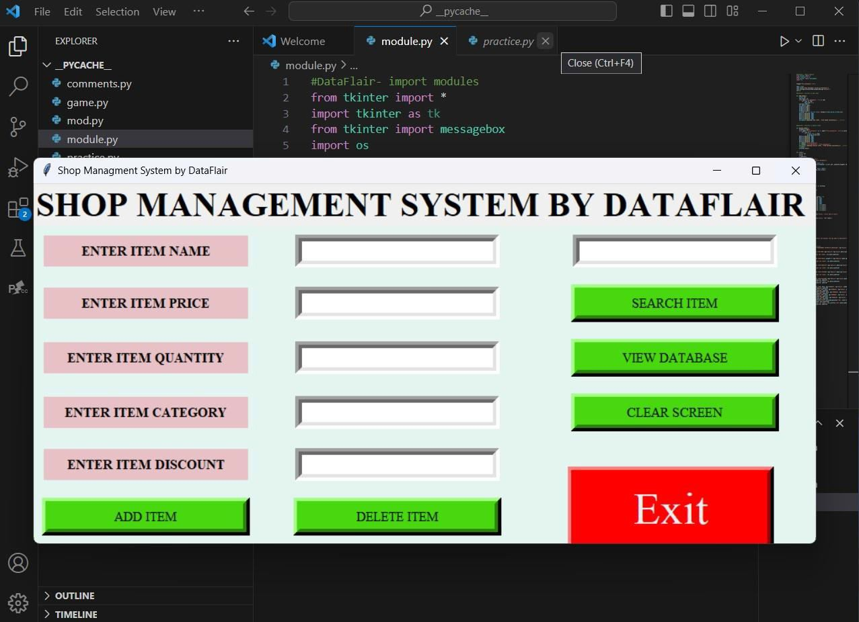
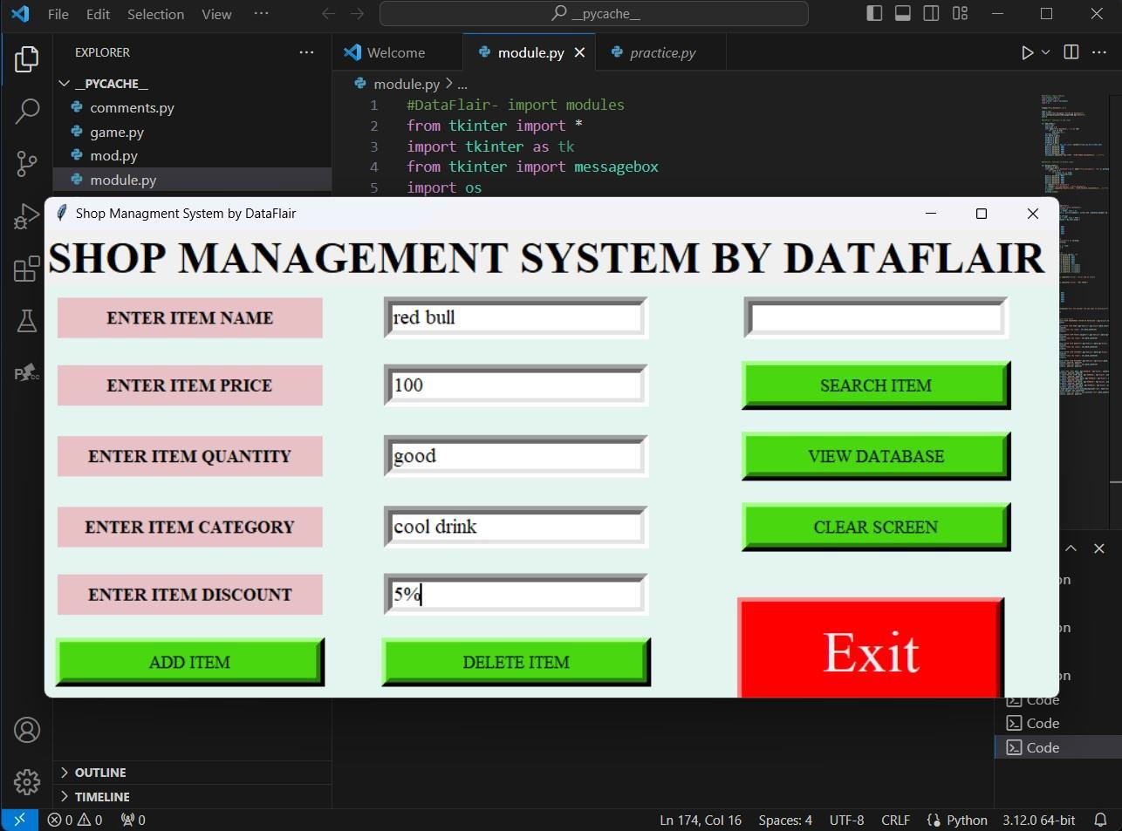
4.OUTPUT SCREENS:
Output-1: After the completion of the execution of code the screen appears as shown in below
Output-2: Enter the details of item and click on the ADD ITEM.

Slide 20
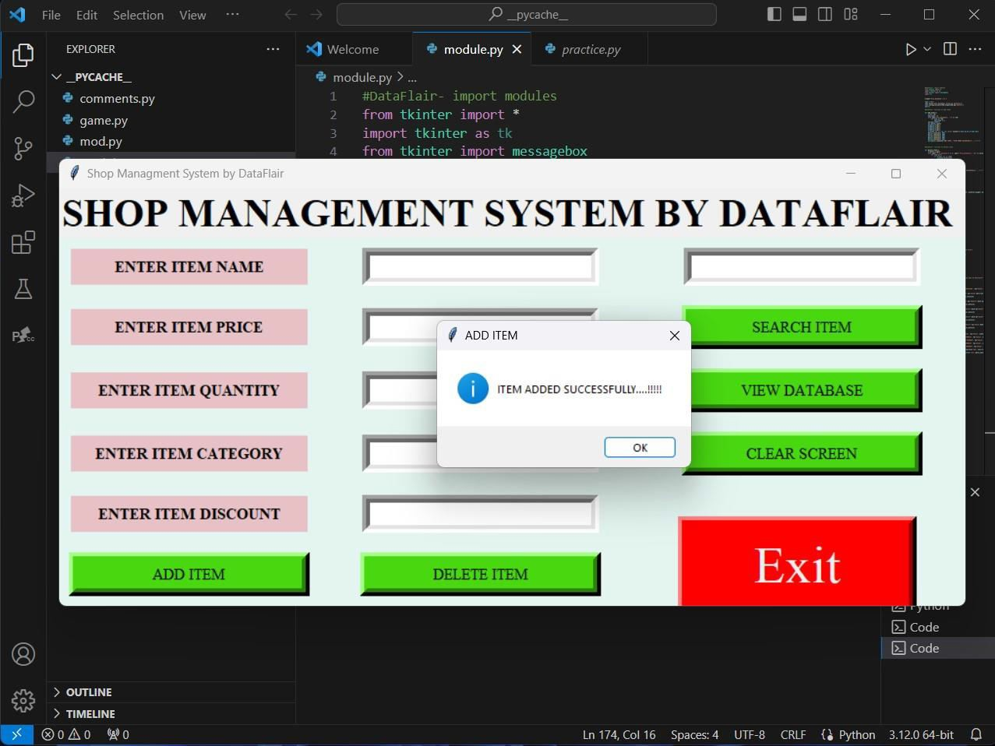
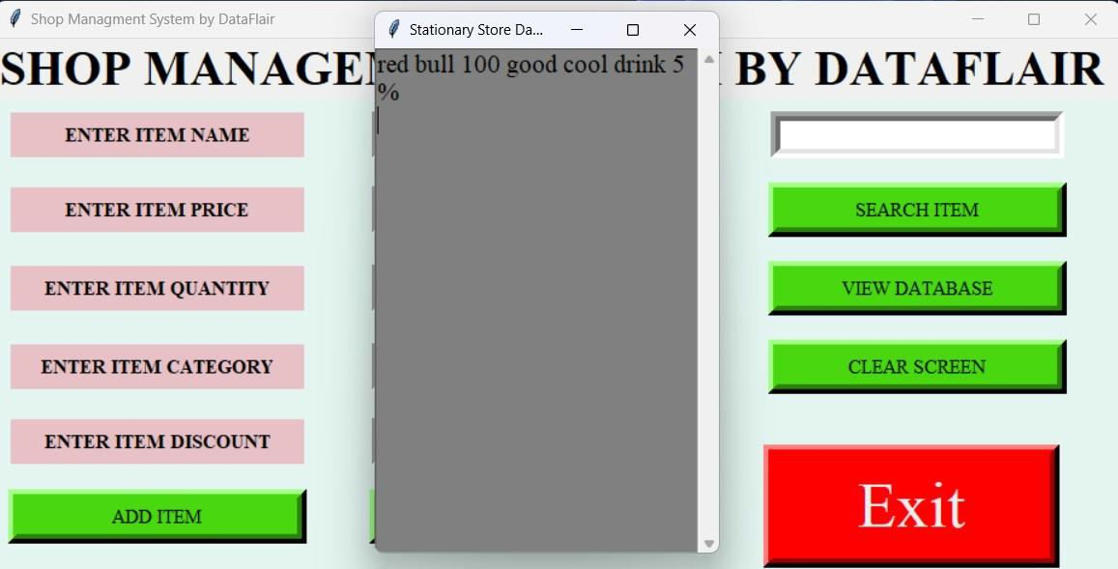
Output-3:The item is added successfully,it is shown as below
Output-4:Now you can see the details by clicking on the VIEW DATABASE.

Slide 21

5.INTERNSHIP FEEDBACK
ABOUT VJ TRAINING CENTRE
The experience has been instrumental in applying theoretical knowledge to real-world scenarios.The internship significantly contributed to the development and application of my technical skills. The internship provided a valuable bridge between my academic studies and practical application, reinforcing concepts learned in my BTech program. I appreciated the opportunity to see how the theoretical knowledge gained in my coursework translates into real- world solutions. The experience allowed me to gain insights into industry practices and trends. I enjoyed working collaboratively with the team and contributing to shop management system.
The constructive feedback and guidance from the team members were invaluable in my
professional growth. The internship challenged me to step out of my comfort zone, fostering personal and professional growth. I am grateful for the mentorship and support that contributed to my overall development during the internship. I look forward to applying the knowledge and skills gained during this internship to my future academic and professional endeavors.
CHALLENGES FACED
The challenges I encountered during my internship at VJ TRAINING CENTRE and share the strategies I employed to address them. While these challenges were significant, they presented valuable learning opportunities that contributed to my professional development.One of the initial challenges I faced was adapting to the new environment and workflow. Coming from an academic background, there was a learning curve in understanding the practical aspects of python.Effective communication within the team posed a challenge, especially in the context of remote work and differing schedules.I am grateful for the support and mentorship provided by the team, which contributed significantly to overcoming these obstacles.

Slide 22
6.CONCLUSION
In conclusion, the Shop Management System has proven to be a pivotal solution in streamlining and enhancing the operational efficiency of our retail establishment. This comprehensive system seamlessly integrates various aspects of shop management, including inventory control, sales tracking, and customer management. The implementation of this system has resulted in a more organized and transparent workflow.The real-time monitoring of inventory levels has significantly reduced instances of stockouts and overstock, optimizing our inventory management practices. The automated sales tracking feature has not only improved accuracy but has also provided valuable insights into consumer preferences and purchasing trends. This, in turn, has empowered us to make data-driven decisions for product restocking and marketing strategies.Moreover, the Shop Management System has elevated customer satisfaction by enabling personalized interactions and efficient order processing. The system's user- friendly interface has facilitated smoother transactions,
enhancing the overall shopping experience for our customers.In essence, the Shop Management System has proven to be an invaluable asset, aligning seamlessly with our business goals and fostering a more competitive and adaptive retail environment. The positive impact on operational efficiency, inventory control, and customer satisfaction positions our business for continued growth and success in the dynamic retail landscape.
6

Slide 23
7.FUTURE SCOPE
The future scope of the Shop Management System lies in potential enhancements and advancements. Improving the graphical user interface (GUI) for a more intuitive and interactive experience is a promising avenue. Integrating advanced security measures, such as encryption and access controls, can fortify the system's integrity and protect sensitive information.Cloud integration stands as a significant prospect, enabling remote access, data backup, and scalability. Mobile compatibility can be explored, allowing users to manage the shop on-the-go through the development of a mobile application.Expanding analytics and reporting capabilities offers opportunities for deeper insights into sales trends, inventory turnover, and financial performance.
Security Measures
Analytics and Reporting Enhancements
Integration with External Systems
4.Cloud Integration
5.Notification System
6.Feedback Mechanism
8.BIBILIOGRAPHY
https://en.wikipedia.org/wiki/Management_system https://pythongeeks.org/python-shop-management-system/
https://www.slideshare.net/MaiwandTechnologix/furniture-shop-management-system- project-report
https://www.scribd.com/document/363209110/Stores-Management-System-Project-
Report
https://www.scribd.com/document/210717538/Shop-Management-System https://in.docworkspace.com/d/sICD399S-AZyG9qwG?sa=e1&st=0t
https://www.academia.edu/37089217/SHOPPING_MANAGEMENT_SYSTEM_Submitted_ by

Slide 24
APPENDIX-A
Sreenidhi Institute of Science and Technology Department of Information Technology Summer Internship-I
Roll number | Name | Title
22315A1223 22315A1227 | Yenkamolla Srinidhi Lakavath Keerthi | Shop Management System
Abstract
Shop management system helps to store the database of the shop including item name, item price, item quantity, item category, item discount. So we can easily find out if we need any data about the shop. Its a very interesting project in python programming. Lets develop shop management system using python modules.Shop Management System is a GUI-based project using Tkinter and a message module used for storing the database of shops.We can add new items that are bought by the customers, we can delete any particular item and we can search for any item. We can view all the databases that we have stored in the file.
Shop management system requires good knowledge of python and the Tkinter library. Tkinter is the python binding to the Tk toolkit which is used across many programming languages for
building the Graphical user interface which is a GUI, known about os library. Also known about the tkinter message box which is used to display the message box on the python game window. To work on this project basic understanding of the os module is also required.
The Shop Management System is a sophisticated and all-encompassing solution that seeks to redefine the landscape of retail operations. At its core, this system is a powerhouse of efficiency, offering an array of features meticulously crafted to enhance every facet of business management.
The management component stands out as a pivotal feature, leveraging advanced algorithms to ensure optimal stock levels. By minimizing the risks of overstock and stockouts, it not only prevents financial losses but also contributes to a seamless customer experience. Real-time sales tracking adds another layer of functionality, providing invaluable insights into product performance, trends, and customer preferences. This data-driven approach empowers businesses to make informed decisions, adapt quickly to market shifts, and stay ahead of the competition.
Student: | Internal Guide | Internship Coordinator | Head of the Department
Y.Srinidhi L.Keerthi | Mr.A.Ravi Kumar Assistant Professor Department of IT | Mrs.N.Sreevidya Assistant Professor Department of IT | Dr.Sunil Bhutada Professor Department of IT

Slide 25

APPENDIX-B
Domain Of Internship and Nature of Internship
Roll number | Name | Title
22315A1223 22315A1227 | Yenkamolla Srinidhi Lakavath Keerthi | Shop Management System
Table 2: Nature of the Project/Internship work (Please tick √ Appropriate for
your Project)
Title | Nature of project
 | Product | Application | Research | Others (please specify)
Shop Management System
Student: | Internal Guide | Internship Coordinator | Head of the Department
Y.Srinidhi L,Keerthi | Mr.A.Ravi Kumar Assistant Professor Department of IT | Mrs.N.Sreevidya Assistant Professor Department of IT | Dr.Sunil Bhutada Professor Department of IT

Slide 26

Table3: Domain of the Project / Internship work (Please tick √ Appropriate
for your Project)
Title | Artificial Intelligence, Machine Learning and Deep Learning | Computer Networks, Information Security and Cyber Security | Data Warehousing, Data Mining and Big Data Analysis | Cloud Computing and Internet of Things | Software Engineering and Image Processing
Shop Management System
Student: | Internal Guide | Internship Coordinator | Head of the Department
Y.Srindhi L.Keerthi | Mr.A.Ravikumar AssistantProfessor Department of IT | Mrs.N.Sreevidya Assistant Professor Department of IT | Dr.Sunil Bhutada Professor Department of IT

